Slide 1
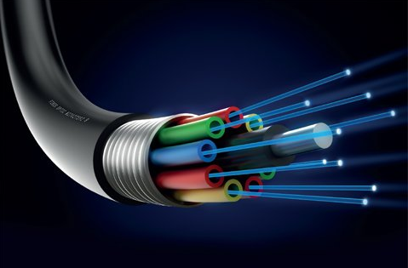
EC2402 -OPTICAL COMMUNICATION AND NETWORKING
INTRODUCTION

Slide 2
OUTLINE
Introduction
General communication system
Optical fiber link
Fiber structure
Fiber types
Optic fiber configuration
Ray theory transmission

Slide 3
INTRODUCTION
Communication – transfer of information from one point to another.
Communication system- transfer of information is achieved by modulating the information onto an electromagnetic wave which acts as a carrier for the information signal.
Electromagnetic wave carrier is selected from
Radio frequencies
Microwave & millimeter wave frequencies
Optical range of frequencies
Limitation- information carrying capability.
Information carrying capability is proportional to the bandwidth of the channel.

Slide 4
Radio Communication System
Information modulates a high frequency carrier.
Information carrying capability – increased.
Bandwidth of the channel – increased.
Available spectrum space – decreased.
Microwave signal
Used as high frequency carriers (1-300GHz).
Cost of equipment – high.
Communication by light
Light act as transmission medium.
Electromagnetic wave carrier- optical range of frequencies (1.76 pHz to 3.75 pHz).
Communication at optical wavelength (800nm to 1700nm) offer a increase in bandwidth by factor of 10⁴.

Slide 5
Information put on a light beam and transmitted through
Free space
Impractical over long distance. Because, attenuation occurs due to atmospheric effects like rain, snow, fog etc.
Special cable- light carrying cable
Optical fiber is a glass or plastic fiber that carries light along its length.

Slide 6
General Communication System

Slide 7
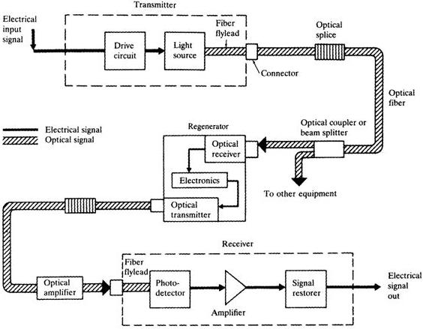
Optical Fiber Comm. Link

Slide 8
Digital Optical Fiber link

Slide 9
Optical Fiber Modes
Optical fiber
Dielectric waveguide
Operates at optical frequency
Cylindrical in form
Modes of the waveguide – the propagation of light along a waveguide can be described in terms of set of electromagnetic waves.
These guided modes are referred to as bound or trapped modes of the waveguide.

Slide 10
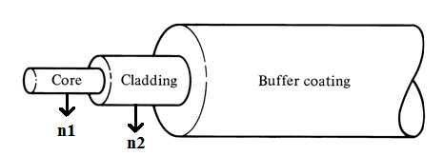
Fiber Structure
It has
Core
Cladding.
Core
Single solid dielectric cylinder
Refractive index – n1
Cladding
Core is surrounded by cladding.
Refractive index – n2 & n2<n1.
Need for cladding
Reduces scattering loss
Provides mechanical strength
Protects core from absorbing surface contaminants.
Fig. Schematic of single fiber structure
Buffer coating
Elastic, absorption resistant material
Use- add further strength to the fiber

Slide 11
Advantages of optical fiber communication
Ultra high bandwidth
Small size and weight
Electrical isolation
Immunity to interference and crosstalk
Signal security
Low transmission loss
Ruggedness and flexibility
System reliability and ease of maintenance
Potential low cost
Point to point communication

Slide 12
APPLICATIONS OF OPTICAL FIBERS…
Long distance communication backbones
Inter-exchange junctions
Video transmission
Broadband services
Computer data communication (lan, wan etc..)
Military application
Non-communication applications (sensors etc…)

Slide 13
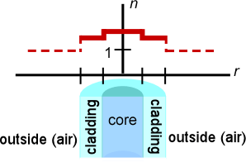
Fiber Types
Variation in material composition of the core gives 2 types of fiber.
Step index fiber
Refractive index of core is uniform throughout and undergoes an abrupt change at the core cladding boundary.

Slide 14
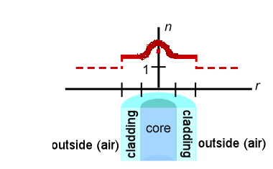
Graded index fiber
Refractive index of core is made to vary as a function of radial distance from the centre of the fiber.
Based on modes 2 types of fibers are available.
Single Mode Fiber.
Multi Mode Fiber.

Slide 15
Comparison
Single mode fiber
Multi mode fiber
Core radius is small.
Supports one mode of propagation.
Optical source- LASER.
The launching of optical power into fiber is difficult as the core radius is small.
Supports larger bandwidth.
Intermodal dispersion is absent.
Used for long distance communication.
Core radius is large.
Supports hundreds of modes.
Optical source- LED.
The launching of optical power into fiber is easier as the core radius is large.
Supports lesser bandwidth.
These fiber suffer from Intermodal dispersion.
Used for short distance communication.

Slide 16
Optic-fiber Configuration

Slide 17
Ray Theory Transmission
Refractive index of a medium
Velocity of light in a medium
=
Velocity of light in a vacuum
Total internal reflection
Refraction
When a ray is incident on the interface between two dielectrics of differing refractive indices (e.g. glass – air) refraction occurs shown in Fig. a.
The angle of incidence φ1 and angle of refraction φ2 is related by Snell's law of refraction
n1 sinφ1 = n2 sinφ2 (or)
sin φ1
n2
=
sin φ2
n1

Slide 18
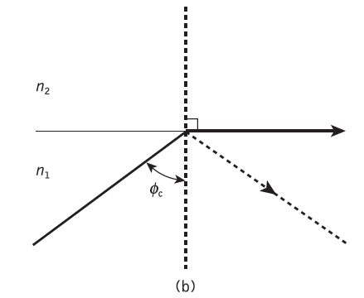
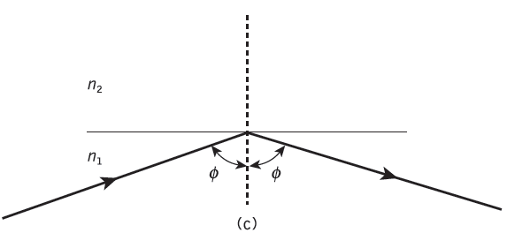
Limiting case of refraction- critical ray at angle φc
Refraction
Total internal reflection

Slide 19
Critical angle
As n1 is greater than n2,the angle of refraction is always greater than the angle of incidence.
Thus when the angle of refraction is 90° and the refracted ray emerges parallel to the interface between the dielectrics, the angle of incidence must be less than 90°. This is the limiting case of refraction and the angle of incidence is now known as the critical angle φc (Fig. b),
Total internal reflection
When light is incident on the dielectric of lower index from the dielectric of higher index an at angles of incidence greater than critical angle. (Fig. c)

Slide 20
Propagation of light wave through Optical fiber
Any light wave which travels along the core and meets the cladding at the critical angle of incidence will be totally internally reflected. Therefore light wave is propagated along the fiber core by a series of total internal reflections.

Slide 21
Acceptance angle
Meridional ray A enters the fiber core at an angle θa.
Incident ray b at an angle greater than θa is refracted into the cladding an eventually lost by radiation.
An acceptance angle defined by the conical half angle θa.
θa is the maximum angle to the axis at which light may enter the fiber in order to be propagated is called acceptance angle for the fiber.

Slide 22
Numerical Aperture (NA)
Numerical aperture of the fiber is the light collecting efficiency of the fiber and is the measure of the amount of light rays that can be accepted by the fiber. It is equal to the sine of acceptance.
NA = n₀ sin θa = (n₁² – n₂²)^{1/2}
where, n₁ and n₂ are the refractive indices of core and cladding respectively.
Numerical aperture of step index fiber is given as
NA = n₁ √2∆

Slide 23
Types of Rays
2 types.
Meridional rays – confined to the Meridional planes of the fiber, which are the planes that contain the axis of symmetry of the fiber.
Types
Bound rays – propagates along the fiber axis according to the law of geometric optics.
Unbound rays – that are refracted out of the fiber.
Skew rays

Slide 24
Skew Rays
Skew rays are the rays following the helical path around the fiber axis when they travel through the fiber and they would not cross the fiber axis at any time.

Slide 25
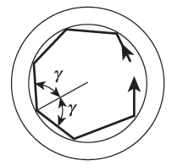
It is not easy to visualize them in two dimensions and hence they are observed in fig.
The helical path traced through
the fiber gives change in direction
of 2γ at each reflection.
Where, γ – angle b/w the projection of
ray and the radius of the fiber core at the point of reflection.

Slide 26
Skew rays depend on the number of reflections they undergo rather than input conditions of the fiber.
When the light input is non-uniform, skew rays tend to have a smoothing effect on the distribution of light as it is transmitted giving a more uniform output.
The amount of smoothing depends on the number of reflections encountered by the skew rays.
In order to calculate acceptance angle for a skew ray, it is necessary to define the direction of ray in 2 perpendicular planes.

Slide 27
Fig : The ray path within the fiber core for a skew ray incident at an angle θs to the normal at the air-core interface

Slide 28
θa for skew rays
sin θas = (n₁² – n₂²)^{1/2} / cos γ
sin θas = NA / cos γ
θa for meridional rays
sin θa = (n₁² – n₂²)^{1/2}

Slide 29
Electro Magnetic Mode Theory
Electro Magnetic Wave Theory
Modes in Planar Waveguide
Phase and Group Velocity

Slide 30
Cylindrical Fibers
Cylindrical fibers discuss the wave guiding mechanism within cylindrical fibers prior to consideration of both step and graded index fiber.
Modes
Mode Coupling
Step Index Fiber
Graded Index Fiber

Slide 31
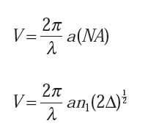
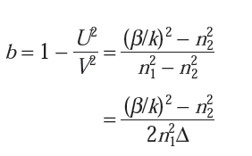
Modes
Normalized frequency (V)
Normalized propagation constant (b)

Slide 32
Mode Coupling
The coupling of energy from one mode to another arises because of
Structural imperfections
Fiber diameter variations
Refractive index variations
Fiber bends
Irregularities at the core- cladding interface

Slide 33
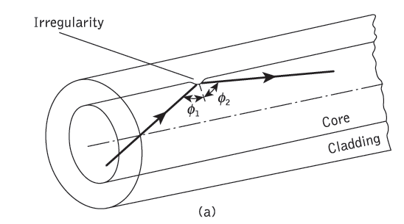
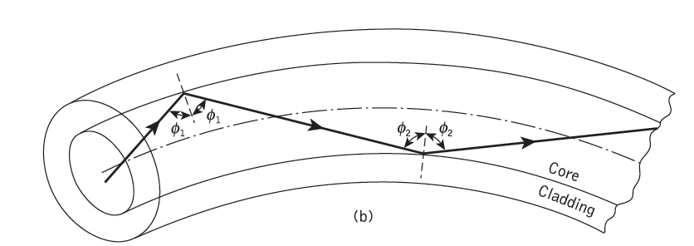
Irregularity
Fiber bend

Slide 34
Mode coupling - The individual modes do not normally propagate throughout the length of the fiber without large energy transfers to adjacent modes, even when the fiber is exceptionally good quality and is not strained or bent by its surroundings. This mode conversion is known as mode coupling or mixing.
Mode coupling analyzed using coupled mode equations from Maxwell's equation.
Mode coupling affects the transmission properties of fiber is dispersive.
It occurs at connectors, splices and other passive components in an optical link.

Slide 35
Step Index Fiber
Refractive index of core n1 is constant and a cladding of a slightly lower refractive index n2 is known as step index fiber.
Refractive index profile for this type of fiber makes a step change at the core–cladding interface.
n(r) = n1 , r < a (core)
n2 , r ≥ a (cladding)
Two types of Step Index fiber.
Multimode Step Index fiber
Single or mono mode Step Index fiber

Slide 36
Multi Mode Step Index Fiber
Core diameter ≥ 50μm, which is large enough to allow the propagation of many modes within the fiber core.
Advantages
More than one mode can be transmitted.
Considerable dispersion occur due to differing in group velocities.

Slide 37
Single / Monomode Step Index Fiber
Core diameter = 2 to 10μm, it allows one mode of propagation within the fiber core.
Advantages
One mode is transmitted.
Low intermodal dispersion.

Slide 38
Comparison
Single mode fiber
Multi mode fiber
Core radius is small.
Supports one mode of propagation.
Optical source- LASER.
The launching of optical power into fiber is difficult as the core radius is small.
Core radius is large.
Supports hundreds of modes.
Optical source- LED.
The launching of optical power into fiber is easier as the core radius is large.

Slide 39
Total number of guided modes or mode value Ms is related to the V value for the fiber
Ms = V² / 2
Where, V - Normalized frequency
which allows the number of guided modes propagating in a multi mode step index fiber.

Slide 40
Graded Index Fiber
Core refractive index decreases continuously with increasing radial distance r from the center of the fiber, but is generally constant in the cladding.
Graded index fiber do not have a constant refractive index in a fiber core.
This index variation represented as
n(r) = n1(1 − 2Δ(r/a)α)^{1/2} , r < a (core)
n1(1 − 2Δ)^{1/2} = n2 , r ≥ a (cladding)
Where, Δ is the relative refractive index difference
α is the profile parameter, which gives the characteristic refractive index profile of the fiber core.
a is core radius.
r is radial distance from the fiber axis

Slide 41
Total number of guided modes or mode value Mg for the graded index fiber
We know that,
For parabolic refractive index profile core fiber has α = 2. Hence,
= V² / 4

Slide 42
Single Mode (SM) Fibers
Designed to allow only one mode of propagation.
For single-mode operation, only LP01 mode can exist. This mode known as fundamental mode of the fiber.
V for SM propagation of LP01 mode in step index fiber is in the range
0 ≤ V < 2.405
Fundamental mode has no cutoff and is always supported by a fiber.

Slide 43
Graded index fiber for single mode operation
Also defined for single mode operation
The cutoff value of normalized frequency Vc to support a single mode in a Graded index fiber is given by,
Vc = 2.405(1 + 2/α)^{1/2}
Using this expression, it is possible to determine the fiber parameter, which give SM operation.

Slide 44
Application
SM fibers recently used for optical communication and telecommunication, because,
It utilize transmission bandwidth effectively.
Lowest losses in transmission media.
Have a superior transmission quality over other fiber types because of the absence of modal noise .
They offer a substantial upgrade capability (i.e. future proofing) for future wide bandwidth services using either faster optical transmitters and receivers.
They are compatible with the developing integrated optics technology.
Long life time.

Slide 45
Parameters to be calculated…
Cutoff Wavelength (λc)
Mode Field Diameter (MFD)
Effective Refractive Index
Group Delay and Mode Delay Factor
The Gaussian Approximation
Equivalent Step Index Methods (ESI)

Slide 46
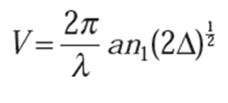
Cutoff Wavelength (λc)
Important transmission parameter
Theoretical value for λc
V in terms of relative refractive index
For step index fiber , Vc = 2.405
Then,
For practical system, value of λc is = 1.3 μm to avoid model noise.
For single mode fiber, value of λc is = 1.1 to 1.28 μm
→

Slide 47
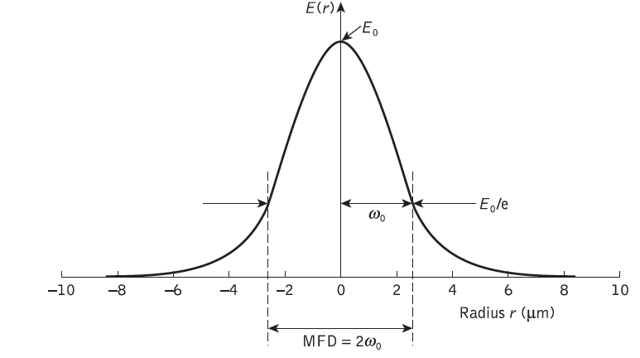
Mode Field Diameter (MFD)
Determined from the mode-field distribution of the fundamental mode LP01.
MFD = 2ω₀
Where, ω₀ – Spot size / Mode-field Radius, which is the nominal half width of the input excitation.

Slide 48
Effective Refractive Index
The rate of change of phase of the fundamental LP01 mode propagating along a straight fiber is determined by the phase propagation constant β.
β is directly related to the wavelength of the LP01 mode λ01 by the factor 2π, since β gives the increase in phase angle per unit length.
Effective Refractive Index referred to as a phase index or normalized phase change coefficient.

Slide 49
n_{eff} is the ratio of the propagation constant of the fundamental mode to that of the vacuum propagation constant.
The wavelength of the fundamental mode λ₀₁ is smaller than the vacuum wavelength λ by the factor 1/neff
Where λ₀₁ = λ / neff
Relationship between neff and b
n₁ k < β < n₂ k
n₁ < n_{eff} < n₂
→

Slide 50
Group Delay and Mode Delay Factor
The transit time or group delay τg for a light pulse propagating along a unit length of fiber is the inverse of the group velocity υg ,
The group index of a uniform plane wave propagating in a homogeneous medium is,
for a single-mode fiber, it is usual to define an effective group index Nge ,

Slide 51
The specific group delay of the fundamental fiber mode becomes,
the effective group index may be written in terms of the effective refractive index neff defined as
β may be expressed in terms of the relative index difference Δ and the normalized propagation constant b by,
β = k[(n₁² − n₂² )b + n₂² ] = kn₂[1 + bΔ]

Slide 52
For weakly guiding fiber, Δ<< 1,
The group delay is
Where, d(Vb)/dV – Mode Delay Factor, which describes the change in group delay caused by the changes in power distribution between fiber core and cladding.

Slide 53
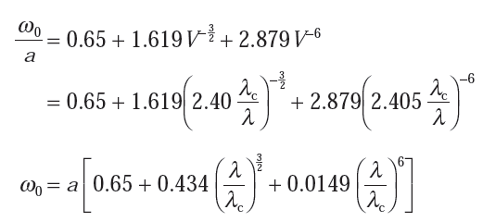
The Gaussian Approximation
Electric field component of the single guided mode may be written as the Gaussian function
Optimum value of ω₀ / a by the empirical formula

Slide 54
Gaussian spot size
Propagation constant
Gaussian approximation is an one parameter (the spot size) to define the radial amplitude distribution.

Slide 55
Equivalent Step Index Methods (ESI)
Approximate values for the cutoff wavelength and spot size in graded index single-mode fibers also obtained using this ESI method.
The effective core radius
Effective normalized frequency
Spot size

Slide 56
PROBLEMS
A multimode step index fiber with a core diameter of 80 μm and a relative index difference of 1.5% is operating at a wavelength of 0.85 μm. If the core refractive index is 1.48, estimate:
(a) the normalized frequency for the fiber;
(b) the number of guided modes.

Slide 57
A graded index fiber has a core with a parabolic refractive index profile which has a diameter of 50 μm. The fiber has a numerical aperture of 0.2. Estimate the total number of guided modes propagating in the fiber when it is operating at a wavelength of 1 μm.

Slide 58
Estimate the maximum core diameter for an optical fiber with the relative refractive index difference (1.5%) and core refractive index (1.48) and the fiber is operating at the same wavelength (0.85 μm). Further, estimate the new maximum core diameter for single-mode operation when the relative refractive index difference is reduced by a factor of 10.

Slide 59
A graded index fiber with a parabolic refractive index profile core has a refractive index at the core axis of 1.5 and a relative index difference of 1%. Estimate the maximum possible core diameter which allows single-mode operation at a wavelength of 1.3 μm.

Slide 60
Determine the cutoff wavelength for a step index fiber to exhibit single-mode operation when the core refractive index and radius are 1.46 and 4.5 μm, respectively, with the relative index difference being 0.25%.

Slide 61
Estimate the fiber core diameter for a single-mode step index fiber which has an MFD of 11.6 μm when the normalized frequency is 2.2.

